Slide 1
OGP Summit Hackathon du Summit du PGO
The Impact of Poverty on
Preparedness in Disaster Management

Slide 2
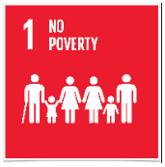

Problem Statement
Vision
Correlation of poverty on disaster management
Analyze if poverty affects our preparedness in handling disaster relief
Issue Statement
Disasters impact a lot of lives and also are a major reason for deaths all over the globe
Our ability to handle disasters is greatly impacted by reasons like poverty and access to resources
These situations can adversely impact people and even cause mass casualties
Method
We are using various software like R, Tableau in evaluating the impact of poverty on disasters
Also, we are investigating whether we have improved in disaster management leading to a decrease in deaths over a period of time

Slide 3
Impact of Disasters Causing Deaths

Slide 4
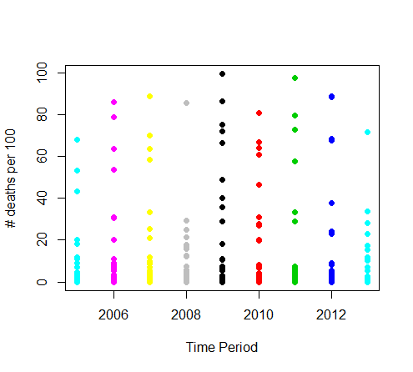
Comparison of the Percentage of Deaths (over people affected including deaths) over a time period (By Country)

Slide 5
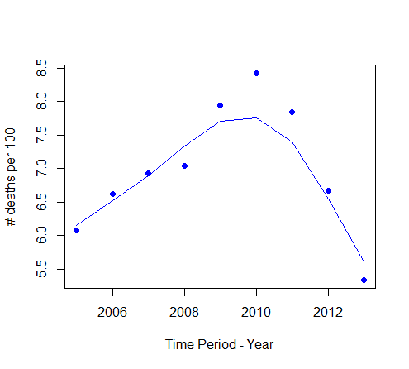
Comparison of the Percentage of Deaths (over people affected including deaths) over a time period (By Country)

Slide 6
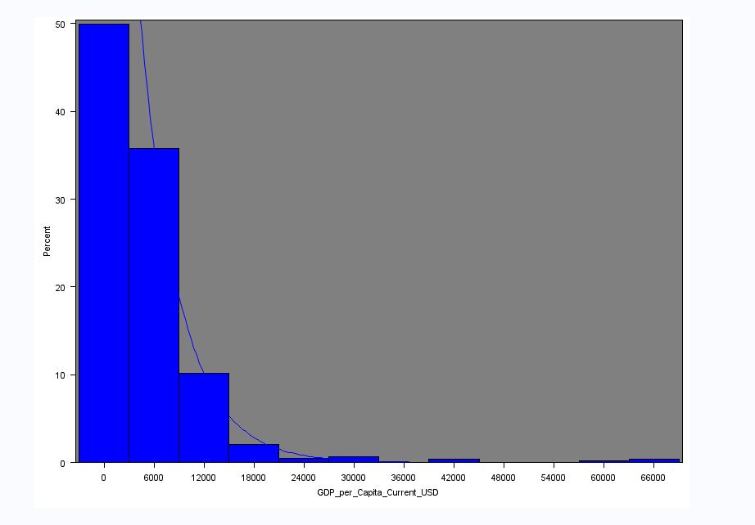
Probability of Deaths from Natural Disaster by GDP per Capita per Country

Slide 7
Tableau Charts

Slide 8
Conclusions
We observed a relationship between poverty and disaster impact
Overall there has been a decrease in the poverty over a period of time
There has also been a decrease in the number of deaths due to natural disasters as seen in the graphs above
We could potentially use machine learning/ predictive modelling to predict future trends and outcomes

Slide 9
Thank You

